Slide 1

Chapter
3
Information Systems, Organizations, and Strategy

Slide 2
Management Information Systems
Chapter 3 Information Systems, Organizations, and Strategy
LEARNING OBJECTIVES
Identify and describe important features of organizations that managers need to know about in order to build and use information systems successfully.
Evaluate the impact of information systems on organizations.
Demonstrate how Porter’s competitive forces model and the value chain model help businesses use information systems for competitive advantage.

Slide 3
Management Information Systems
Chapter 3 Information Systems, Organizations, and Strategy
LEARNING OBJECTIVES (Continued)
Demonstrate how information systems help businesses use synergies, core competencies, and network-based strategies to achieve competitive advantage.
Assess the challenges posed by strategic information systems and management solutions.

Slide 4
Management Information Systems
Chapter 3 Information Systems, Organizations, and Strategy
Will the New US Airways Be Able to Fly?
Problem: Intense competition and environmental changes.
Solutions: Revising business processes and integrating them with information systems and culture could increase sales and reduce costs.
Selecting appropriate systems and technology eliminates redundant systems.
Demonstrates IT’s role in supporting improved business processes.
Illustrates the benefits of integrating information systems in the face of interdependence of environment, culture, process, strategy, and systems.

Slide 5
Management Information Systems
Chapter 3 Information Systems, Organizations, and Strategy
Organizations and Information Systems
What is an organization?
Features of organizations
  Routines and business processes
  Organizational politics
  Organizational culture
  Organizational environments
  Organizational structure
  Other organizational features

Slide 6
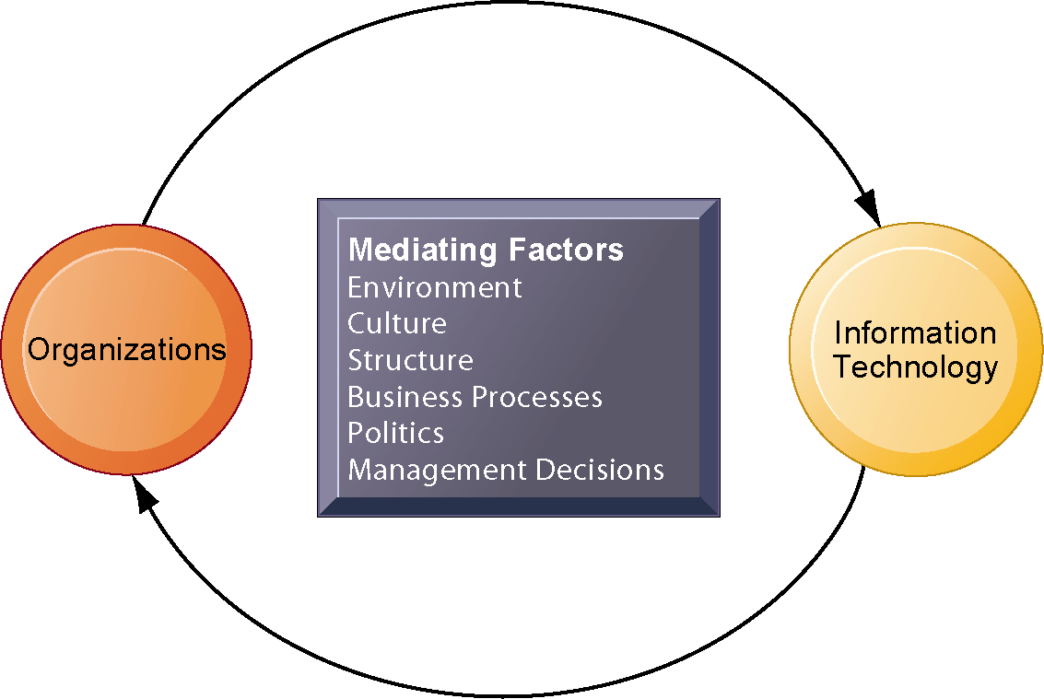
Management Information Systems
Chapter 3 Information Systems, Organizations, and Strategy
Organizations and Information Systems
The Two-Way Relationship Between Organizations and Information Technology
This complex two-way relationship is mediated by many factors, not the least of which are the decisions made—or not made—by managers. Other factors mediating the relationship include the organizational culture, structure, politics, business processes, and environment.
Figure 3-1

Slide 7
Management Information Systems
Chapter 3 Information Systems, Organizations, and Strategy
How Information Systems Impact Organizations and Business Firms
Economic impacts
Organizational and behavioral impacts
  IT flattens organizations
  Postindustrial organizations
  Understanding organizational resistance to change
The Internet and organizations
Implications for the design and understanding of information systems

Slide 8
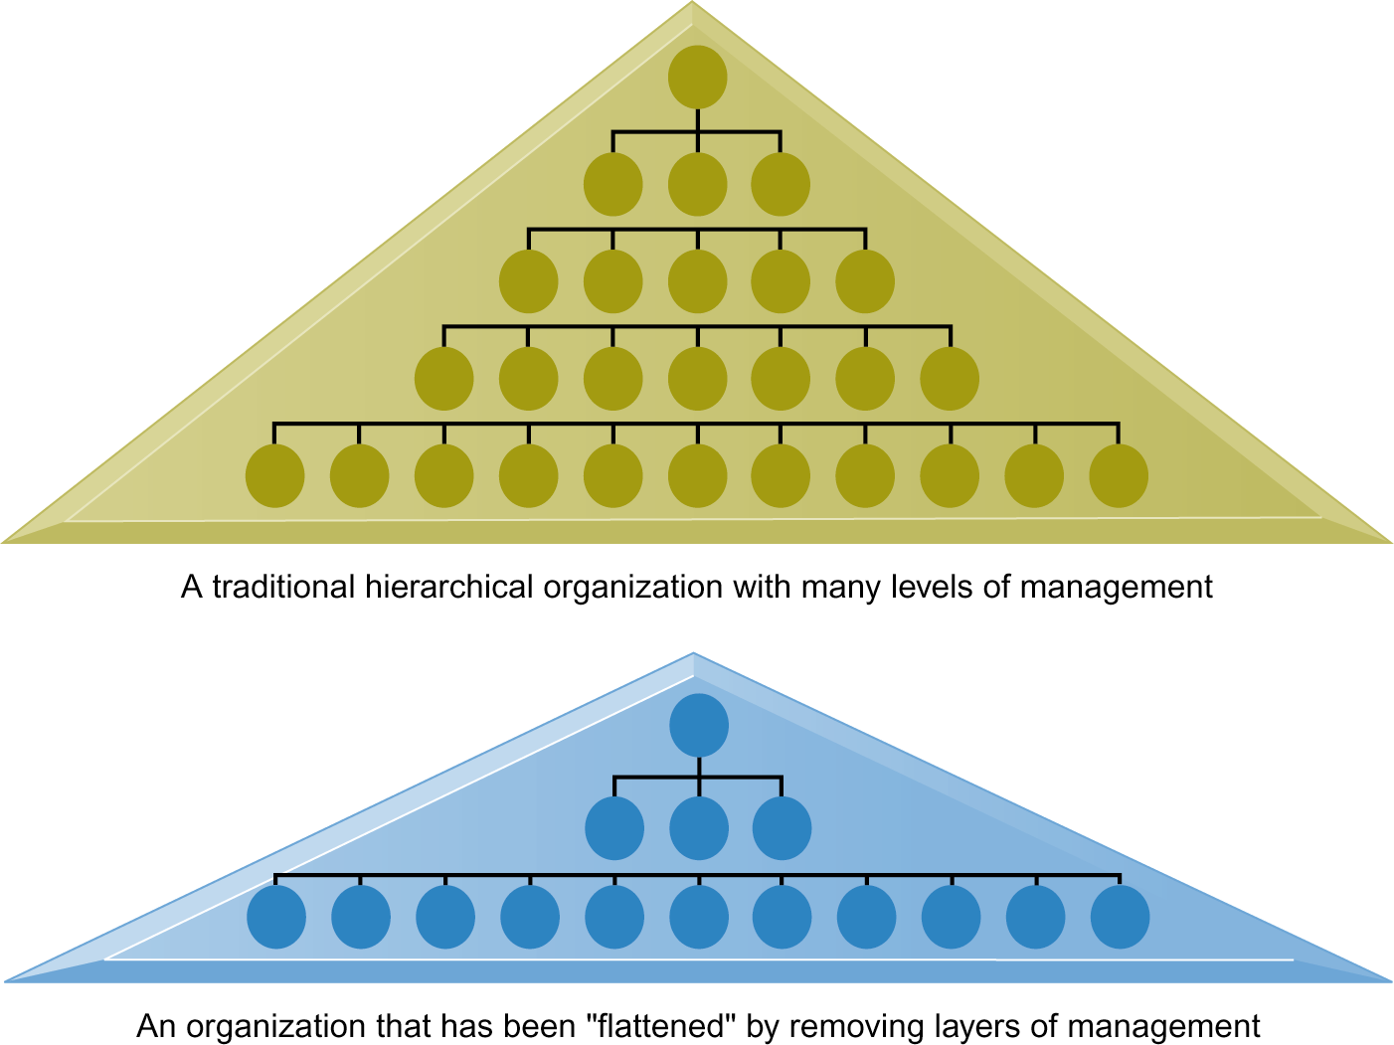
Management Information Systems
Chapter 3 Information Systems, Organizations, and Strategy
How Information Systems Impact Organizations and Business Firms
Flattening Organizations
Information systems can reduce the number of levels in an organization by providing managers with information to supervise larger numbers of workers and by giving lower-level employees more decision-making authority.
Figure 3-8

Slide 9
Management Information Systems
Chapter 3 Information Systems, Organizations, and Strategy
Using Information Systems to Achieve Competitive Advantage
Porter’s Competitive Forces Model
Traditional competitors
New market entrants
Substitute products and services
Customers
Suppliers

Slide 10
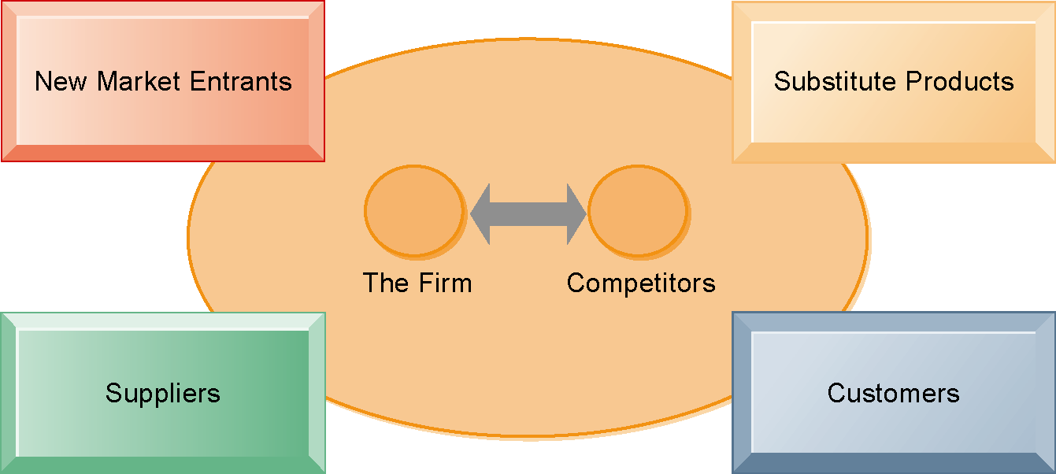
Management Information Systems
Chapter 3 Information Systems, Organizations, and Strategy
Using Information Systems to Achieve Competitive Advantage
Porter’s Competitive Forces Model
In Porter’s competitive forces model, the strategic position of the firm and its strategies are determined not only by competition with its traditional direct competitors but also by four forces in the industry’s environment: new market entrants, substitute products, customers, and suppliers.
Figure 3-10

Slide 11
Management Information Systems
Chapter 3 Information Systems, Organizations, and Strategy
Using Information Systems to Achieve Competitive Advantage
Information systems strategies for dealing with competitive forces
Low-cost leadership
Product differentiation
Focus on market niche
Strengthen customer and supplier intimacy
The Internet’s impact on competitive advantage

Slide 12
Management Information Systems
Chapter 3 Information Systems, Organizations, and Strategy
Using Information Systems to Achieve Competitive Advantage
7-Eleven Stores Ask the Customer by Asking the Data
Read the Interactive Session: Technology, and then discuss the following questions:
  Why is knowing about the customer so important to a company such as 7-Eleven?
  What are the benefits of 7-Eleven’s Retail Information System?
  In terms of Porter’s model, what strategic forces does the Retail Information System seek to address?
  Which of the strategies described in the chapter does the Retail Information System support?

Slide 13
Management Information Systems
Chapter 3 Information Systems, Organizations, and Strategy
Using Information Systems to Achieve Competitive Advantage
The business value chain model
Extending the value chain: The value web
Synergies, core competencies, and network-based strategies
Synergies
Enhancing core competencies
Network-based strategies
  Network economics
  Virtual company strategy
  Business ecosystems: Keystone and niche firms

Slide 14
Management Information Systems
Chapter 3 Information Systems, Organizations, and Strategy
Using Information Systems to Achieve Competitive Advantage
Amazon.com: An Internet Giant Fine-Tunes Its Strategy
Read the Interactive Session: Organizations, and then discuss the following questions:
  Analyze Amazon.com using the competitive forces and value chain models. How has it responded to pressures from its competitive environment? How does it provide value to its customers?
  Describe Amazon’s evolving business strategy.
  Why did the company change its strategy?
  Do you think Amazon can continue to be successful? Explain your answer.

Slide 15
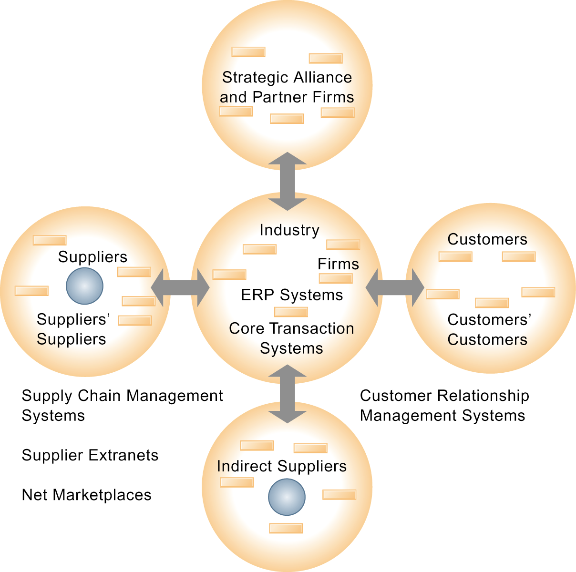
Management Information Systems
Chapter 3 Information Systems, Organizations, and Strategy
Using Information Systems to Achieve Competitive Advantage
The Value Web
The value web is a networked system that can synchronize the value chains of business partners within an industry to respond rapidly to changes in supply and demand.
Figure 3-12

Slide 16
Management Information Systems
Chapter 3 Information Systems, Organizations, and Strategy
Using Systems for Competitive Advantage: Management Issues
Sustaining competitive advantage
Performing a strategic systems analysis
Managing strategic transitions

